Slide 1
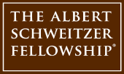
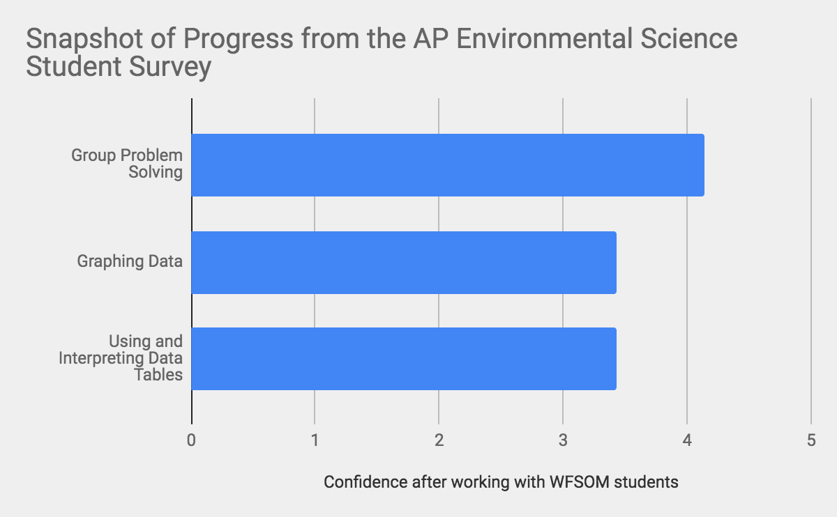
Enhancing Accessibility in Scientific Education
Brittany Liebenow and Kevin Wang, 2018-19 NC Schweitzer Fellows
Mission
Sustainability
Access to scientific educational
opportunities in high school shapes interest in scientific careers and scientific literacy.
As Schweitzer fellows, we are impacting a historically educationally underserved population by offering resources to inspire students academically and by providing support for biology and chemistry classes from Spring 2018-Spring 2019.
Services include in-school after-school lab and activity sessions every 2 weeks in AP Environmental Science and Chemistry (~10-15 students per class, ~30 students overall) in addition to individual mentoring at Carver High School.
Dr. Stan Hill, Director of The Center of Excellence for Research, Teaching and Learning (CERTL), serves as Brittany and Kevin's Academic Mentor. Kim Campbell, Senior Lead Trainer for CERTL, serves as their Site Mentor at Carver High School.
Scholars United Now (SUN) will continue to operate under CERTL and will be lead by current medical students Stan Green and Michael Jones. We will continue to expand our services provided and improve our data collection.
We would like to thank the Fellowship, our mentors, and our students for making the dream for this program a reality.
Results

